Slide 1
DOES GOD EXIST?
What do you mean by “God”?

Slide 2
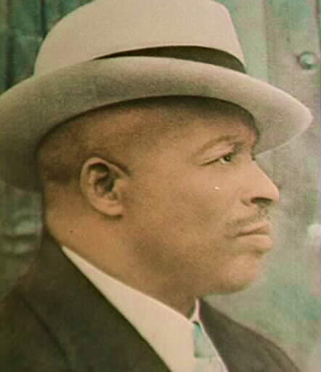
Father Divine?

Slide 3
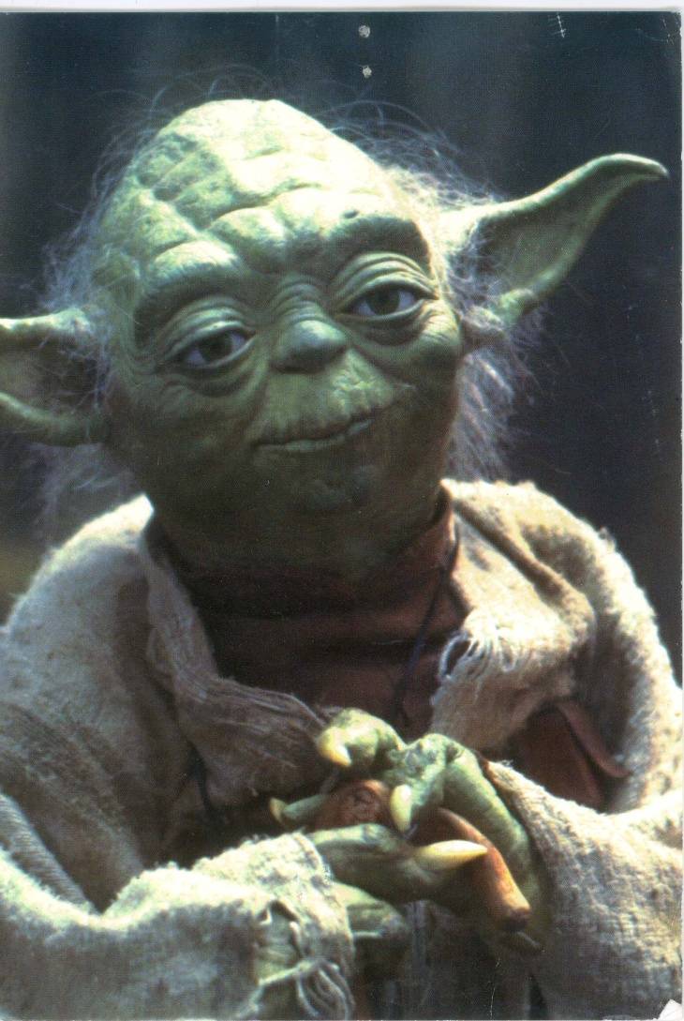
The Good Side of the Force?

Slide 4
What attributes would something have to have in order to be God ?
Omniscience
Omnipotence
Omni-benevolence
Creator of the Universe

Slide 5
We shall mean by “God”:
A being who is omniscient, omnipotent, and omni-benevolent … or at least very knowledgeable, very powerful, and very good… and who created the Universe.
Our question: “What reasons are there to believe or disbelieve in the existence of a being who has some or most of these attributes?”

Slide 6
“No intelligent person could believe in God”
Isaac Newton 
Albert Einstein (Spinozian God) 
James Clerk Maxwell 
Niels Bohr 
Werner Heisenberg 
Galileo Galilei 
Richard Feynman X
Paul Dirac X
Erwin Schroedinger 
Ernest Rutherford 
Kurt Goedel 

Slide 7
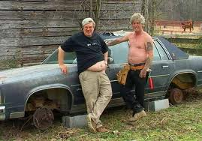
TYPICAL THEISTS

Slide 8
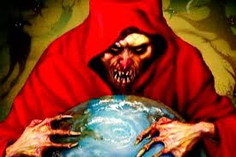
TYPICAL ATHEIST

Slide 9
WE WILL CONSIDER THE FOLLOWING THREE QUESTIONS
IS IT REASONABLE TO BELIEVE THAT
MIRACLES
HAVE OCCURRED THAT WOULD CONFIRM THE EXISTENCE OF GOD?
IS IT REASONABLE TO BELIEVE THAT THERE IS A GOD GIVEN ALL THE EVIL THAT THERE IS IN THE WORLD?
IS IT REASONABLE TO BELIEVE THAT THERE IS A GOD THAT HAS BEEN DIRECTLY EXPERIENCED BY SOME PEOPLE ?

Slide 10
ASSIGNMENT
1. ORDER ONLINE THE TEXT: RICHARD SWINBURNE (ED.), MIRACLES (DO THIS TODAY!).
2. READ: PART ONE OF DAVID HUME’S “OF MIRACLES”: ONLINE AT
http://www.bartleby.com/37/3/14.html
3. STUDY HANDOUTS ON LOGIC.

